Slide 1



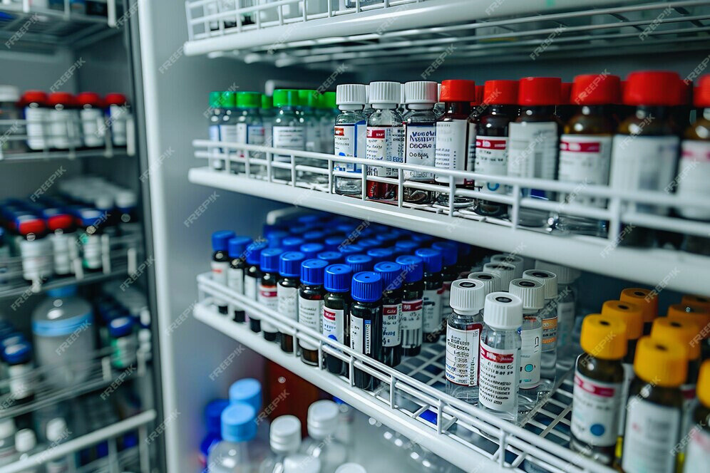
SWE 4304
PHARMA
SYNC
Presented by :
Ahnaf Shahriar Pias ( 220042146 )
Md. Sameur Rahman ( 220042144 )
Irfan Shafee ( 220042164 )
===================================

Slide 2
PROJECT OVERVIEW
--> Enables efficient management of medicine inventories with detailed information
--> Supports sorting and filtering while viewing medicines.
--> reporting features that alert about expiring medicines and low stock levels
--> Ensures that the pharmacy remains well-stocked

Slide 3


KEY
FEATURES
View Medicine
Stock Manipulation
1
1
Add Medicine
Search
2
Sort
2
Update
Name
Price
Generic Name
Quantity
Expiry Date
3
Delete
Quantity
3
Filter
Quantity
Supplier
Notes:
3

Slide 4

KEY
FEATURES
Sell Medicine
Notification
1
Add items to Cart
1
Notification for expiry
2
View Cart / Empty Cart
2
Notification for low stock
3
Checkout
4
Print Recipt
5
Supplier Rating
Selling History
6
Automated Stock Reduction
1
Sales Count
2
Rankings

Slide 5





Tools & Technologies

Slide 6
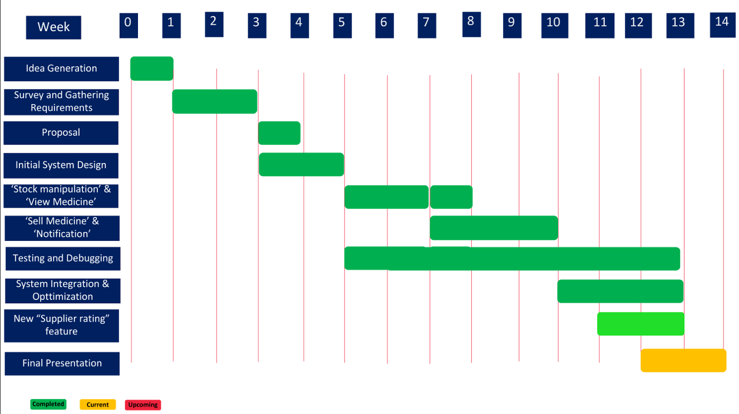
Project Timeline

Slide 7
== DEMO ==

Slide 8
==* THANK YOU *==

